Slide 1
ServiceNow Partner – Drive future Thought Leadership/research and solutioning (SAMPLE SET)

Slide 2
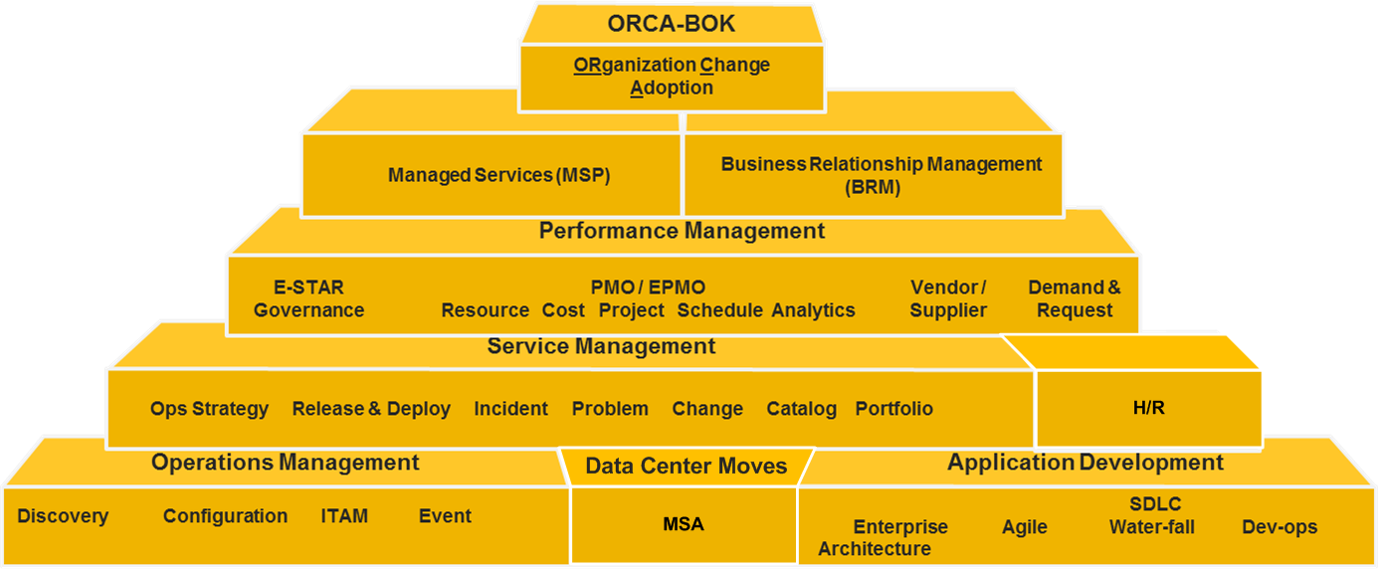
We Have ServiceNow Covered

Slide 3
Digital Transformation …….

Slide 4
How Is The Industry Doing? (Forrester & Capgemini……..,)
Capability | 2012 | 2018 | Trend
Adequate Leadership Capabilities | 45% | 35%
Shared Executive Vision | 44% | 31%
Executive Understanding of IT Role in Organization | 65% | 37%
Executive Understanding of how IT can Increase Productivity | 59% | 35%
Clear Definition of Digital Initiatives | 38% | 32%
Executive View of IT Investment Priorities | 53% | 36%
Leadership Engagement of Employees in Dialog | 49% | 36%
Realtime Monitoring of Operations | 48% | 35%
Operations Excellence | 50% | 36%
Digital Effort Alignment with Corporate Objectives | 40% | 45%
Leading Edge Technology Investment | ‒ | 29%
Adequate Digital Capabilities | ‒ | 39%
Executive Need to Drive Supportive Culture Change | ‒ | 37%

Slide 5
Who is Involved in Digital Transformation
Digital Transformation involves technology integration with the journey of
Employees
Business partners
Providers
Customers
Other stakeholders

Slide 6
Unleashing the Power of BRM
In the age of digital transformation BRM is about
Coordinating Transformation
Acting as Translator
Sharing Ownership
Power to
BRM

Slide 7
Managing Digital Transformation with BRM
When faced with opportunity overload…
start small, build trust and demonstrate value

Slide 8
Why OCM?
85% of all projects fail to deliver expected ROI
REASON: Lack of Culture buy-in and on time adoption

Slide 9
Estimated Engagement Duration, Consultant Effort & Cost
Engagement | Duration | Estimated Hours |  | Estimated Cost
Change Assessment | …..weeks | ….. |  | ……..
Change Sprints | ….. weeks | ….. |  | ……………
OCM & Communication | ………..
End-to-End Organization Change Mgmt | …….months | Variable | $750K +….

Slide 10
Estimated Client Time Commitment for Change & Adoption
Client Organization Change Management Team and/or Change Management Steering Committee
2-4 hours per week for duration of organization change portion of engagement
Additional time for coordination of messaging and communication rollout
Process owners & Key process stakeholders
1-2 hours per week per sprint
Additional time for training
NOTE: Weekly time commitment for process owners may be managed by
Managing order of sprints
e.g. sprints that include the same process owners care not concurrent
Level process owner involvement across the sprints
e.g. individual process owners are not included in every sprint
Stretch sprint deployment by timing sprints
e.g. spacing sprints every two weeks instead of every week

Slide 11
Roadmap to Customer Superior Service
5
Business Process
Understand/document current state of IT Processes
Provide Maturity Assessment
CMDB
Use Service Now to build configuration management data base
Change Management
Implement an automated method to track IT Operations changes
Develop methods to continuously improve IT infrastructure through practices that use data for prioritization and decision making
Provide Roadmap to Improvement
Use auto-discovery tools to quickly populate assets
Document relationships that matter most

Slide 12
IT Operations Excellence™ Projects
Customized for unique client requirements to:
◊ Increase IT’s Customer Satisfaction
◊ Lead to IT’s Financial Prudence
◊ Improve IT’s Employee Productivity

